Slide 1

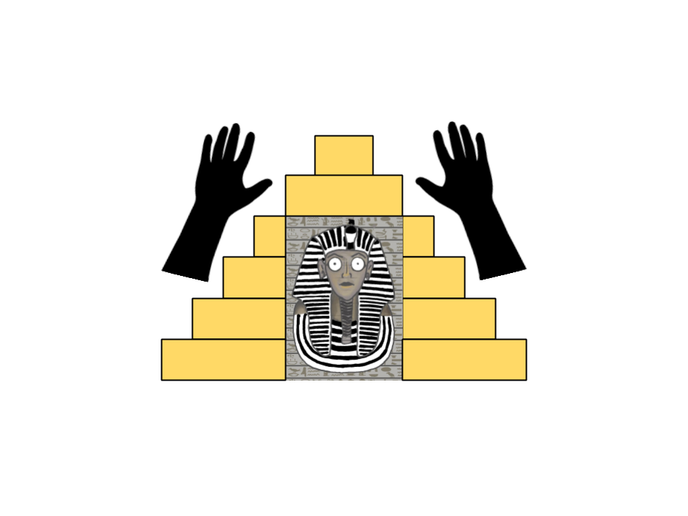
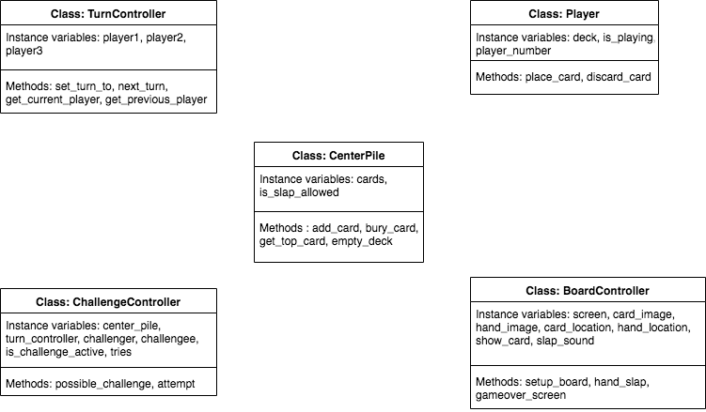
Team 11
Egyptian Slap
Operation Catapult 2019
By : Evan and Nikhil
Project Description:
The game programmed is a strategy card game, that goes by the name of Egyptian Ratscrew. The winner of the game is the player who wins all the cards in the game. It is a 2-4 player game, that involves a deck of 52 cards randomly distributed amongst the players. The players can’t look at their cards as they remain face down in front of them. Players play one card each in order of turns, and when two identical cards appear, any player can ‘slap’. Players can also slap when a double with a card of different value between the two matching cards (like when a 5, 8, 5) is played. Whoever slaps, gets all the cards that were stacked on the center pile. Slapping when there is no slapping opportunity is considered a foul, and the player places his next card under the center pile. If any face card or ace is placed down on the center pile, the player who placed the face card ‘challenges’ the next player. The next player has a set amount of tries to place down another face card or ace to win the challenge (J – 1 try, Q – 2 tries, K – 3 tries, A – 4 tries).
→ Slap
UML Diagram:
→ Sandwich Slap
→ Queen Challenge failed
(No face card or ace was placed by challengee after queen was placed by challenger)
Problems faced:
Conclusion:
Coding the slapping function was
difficult as we ran into many
problems due to the intricate
rules of the game that had to be
regarded.
We also had problems on how to
shuffle and distribute the deck
amongst players.
Lining the visuals of the game on
the display screen required
accurate alignment as well.
After brainstorming different game ideas, we narrowed down on Egyptian Ratscrew. After planning out the different classes and methods before coding, it allowed us to have a clear flow during the coding process. We finally tackled the obstacles in the coding process, through creativity as well as trial and error..

